Slide 1
HELLO, KIDS!
HOW ARE YOU?

Slide 2
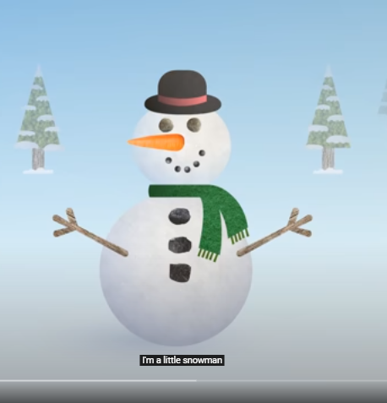

Slide 3
LET‘S SING AND MOVE!
https://www.youtube.com/watch?v=FczqntFwb6k

Slide 4
LET‘S DRAW A SNOWMAN!

Slide 6
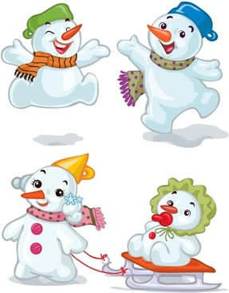
LET‘S DRAW FUNNY SNOWMEN!

